Slide 1

Data as a Signal and Correlation Data X: A Course on Data, Signals, and Systems
Data ^{X}
About Me:
Ikhlaq Sidhu Chief Scientist & Founding Director, Sutardja Center for Entrepreneurship & Technology IEOR Emerging Area Professor Award, UC Berkeley

Slide 2
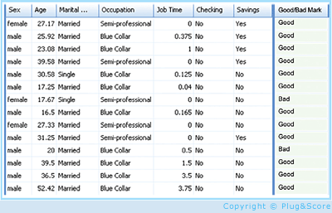
A High Level Framework
Features, but also loss of information
Some data has observed results
In Real Life
Objects
Events/Experiments
People/Customers
Products
Stocks
…
Person 1
Person 2
Person 3
.
.
.
Person N
In Sample
Out of Sample
Characteristics
Patterns
Models
Predictions
Similarities
Differences
Distance

Slide 3
Converting From Time Sequence Data to Features
Of course, not all data has a time property, but lets start with this type.
For example( key1, value 1),( key 2, value 2)… in this case, the keys are indexed by time.

Slide 4
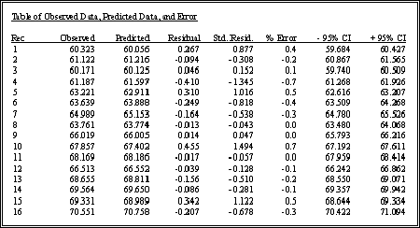
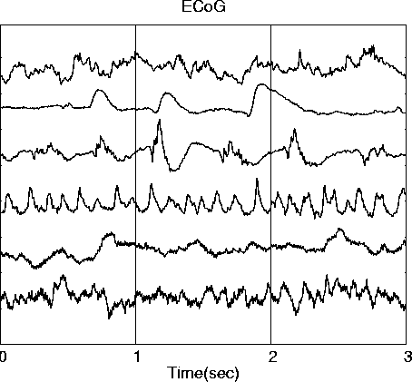
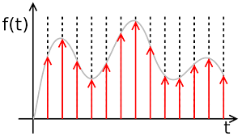
Converting From Time Sequence Data to Features
Many Types of data are signals in time
Stock market
Temperature
Instrument readings
Sometimes we sample them, record at intervals of T
We get a
list in a table, array, or vector
What we want (for now): features and characteristics
For example:
Means
Variances
Patten matches
Changes
accumulation
Frequency
Discrete data
x_{n} = x1, x2, x3, …
Continuous signals
x(t)
Sampled signals (data)
x(nT)
(might lose time reference)

Slide 5
Converting From Time Sequence Data to Features
Many Types of data are signals in time
Stock market
Temperature
Instrument readings
Sometimes we sample them, record at intervals of T
We get a
list in a table, array, or vector
What we want (for now): features and characteristics
For example:
Means
Variances
Patten matches
Changes
accumulation
Frequency
Discrete data
x_{n} = x1, x2, x3, …
Continuous signals
x(t)
Sampled signals (data)
x(nT)
(might lose time reference)

Slide 6
Converting From Time Sequence Data to Features
Many Types of data are signals in time
Stock market
Temperature
Instrument readings
Sometimes we sample them, record at intervals of T
We get a
list in a table, array, or vector
What we want (for now): features and characteristics
For example:
Means
Variances
Patten matches
Changes
accumulation
Frequency
Discrete data
x_{n} = x1, x2, x3, …
Continuous signals
x(t)
Sampled signals (data)
x(nT)
(might lose time reference)

Slide 7
Converting From Time Sequence Data to Features
Many Types of data are signals in time
Stock market
Temperature
Instrument readings
Sometimes we sample them, record at intervals of T
We get a
list in a table, array, or vector
What we want (for now): features and characteristics
For example:
Means
Variances
Patten matches
Changes
accumulation
Frequency
Discrete data
x_{n} = x1, x2, x3, …
Continuous signals
x(t)
Sampled signals (data)
x(nT)
(might lose time reference)

Slide 8
Converting From Time Sequence Data to Features
Many Types of data are signals in time
Stock market
Temperature
Instrument readings
Sometimes we sample them, record at intervals of T
We get a
list in a table, array, or vector
What we want (for now): features and characteristics
For example:
Means
Variances
Patten matches
Changes
accumulation
Frequency
But from when, and over what time period
Discrete data
x_{n} = x1, x2, x3, …
Continuous signals
x(t)
Sampled signals (data)
x(nT)
(might lose time reference)

Slide 9
Approaches to the Data Sequences in Tables
Time ->
One row for each source
A, B, C, D..
Eg Numpy arrays
A: x1, x2, x3, …
B: x1, x2, x3, …
C: x1, x2, x3, …
D: x1, x2, x3, …
A
.
.
D
A
x1
x2
x3
.
.
B
x1
x2
x3
.
.
C
x1
x2
x3
.
.
One column
for each series:
A , B, C, D..
eg Pandas
(add rows with every new time sample)
1
2
3
.
.
Discrete data for
each source
A, B, C..
x_{n} = x1, x2, x3, …

Slide 10
Approaches to the Data Sequences in Tables
Time ->
One row for each source
A, B, C, D..
Eg Numpy arrays
A: x1, x2, x3, …
B: x1, x2, x3, …
C: x1, x2, x3, …
D: x1, x2, x3, …
Preprocess:
Filter/
Convolution
Correlation
Mean, var, stats
Windows of time
A
If ML:
Table of (X,Y)
for
Prediction
Classification
.
.
Features
D
A
x1
x2
x3
.
.
B
x1
x2
x3
.
.
C
x1
x2
x3
.
.
One column
for each series:
A , B, C, D..
eg Pandas
(add rows with every new time sample)
1
2
3
.
.
Discrete data for
each source
A, B, C..
x_{n} = x1, x2, x3, …
Data Input and Storage
Preprocessing
ML for Decisions

Slide 11
Data Sequence in Tables Example
Preprocess:
Filter/
Convolution
Correlation
Mean, Var, stats
Freq. /Spectral
Windows of time
 | Price | Price[n-20] | 20 day MA | 1 year average | Expected Price?
APPL | appl[n] | appl[n-20] | mva(appl, 20) | mva(appl, 200)
FB | fb[n] | fb[n-20] | mva(fb,20) | mva(fb,200)
GOOG | goog[n] | goog[n-20] | mva(goog, 20) | mva(goog, 200)
Apple
.
.
Google
data
features
Discrete data for
each source
A, B, C..
x_{n} = x1, x2, x3, …
Data Input and
Temp Storage
Preprocess
(and lose
some information)
ML for Decisions / Predictions

Slide 12
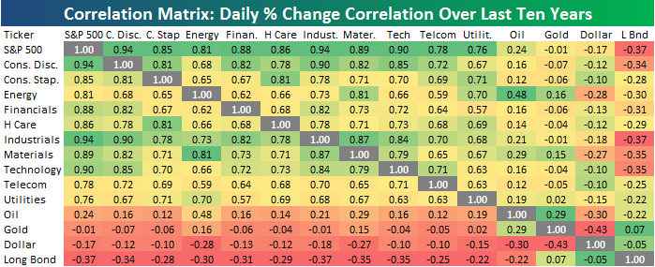
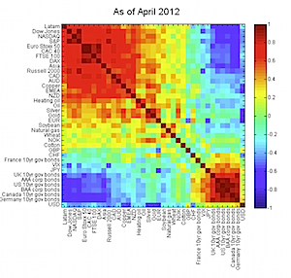
Data Sequence in Tables Example
Preprocess:
Filter/
Convolution
Correlation
Mean, Var, stats
Freq. /Spectral
Windows of time
Apple
.
.
Google
Correlation
Matrix
data
features
Discrete data for
each source
A, B, C..
x_{n} = x1, x2, x3, …
Data Input and
Temp Storage
Preprocess
(and lose
some information)
Descriptive Statistics

Slide 13
Data Sequence in Tables Example
Image
A
Preprocess:
Filter/
Convolution
Correlation
Mean, Var, stats
Freq. /Spectral
Windows of space
Features
..
A: x1, x2, x3, …
B: x1, x2, x3, …
C: x1, x2, x3, …
D: x1, x2, x3, …
Image
D
data
features
If ML: Table of (X,Y) for
Prediction Classification
Discrete data for
each source
A, B, C..
x_{n} = 2-D Array
Preprocess
(and lose
some information)
Data Input and
Temp Storage

Slide 14
Correlation Matrices

Slide 15
Correlation and Covariance

Slide 16
Correlation and Covariance
Properties

Slide 17
Correlation Matrix
Table
Window W
x1 x2 … xn
Samples
1
2
3
n
.
.
N+W
x1
Multiple
Sources
x2
xn
Samples from Window of W
Many samples, or a sequence in time
x1(t), x2(t), .. xn(t)
To estimate from data:
Use all samples ever collected
Use window size of W samples of each to estimate a recent Corr Matrix

Slide 18
Correlation Matrix
Corr(x1,x1) = 1
Corr(x2, x1)
= E[ x2 x1 – E[x2]E[x1] ] / stdev(x1) stdev(x2)
You could even do this by hand:
Corr(x1,x1) ……..
Corr(x1,xn)
Corr(xn,x1)
x1 x2 E[x1 x2] E[x1] E[x2]
1 2 2 1.5 2.5 2 4 1 1 2 3
Corr(xn,xn)
To estimate from data:
Use all samples ever collected
Use window size of W samples of each to estimate recent Corr Matrix

Slide 19
Code Examples: Correlation of Rows with NumPy
Import numpy as np
# ignore line formatting
x = np.array(
[[0.1, .32, .2, 0.4, 0.8],
[.23, .18, .56, .61, .12],
[.9, .3, .6, .5, .3],
[.34, .75, .91, .19, .21]])
np.corrcoef(x)
Out[4]: array([
[ 1. , -0.35153114, -0.74736506, -0.48917666],
[-0.35153114, 1. , 0.23810227, 0.15958285],
[-0.74736506, 0.23810227, 1. , -0.03960706],
[-0.48917666, 0.15958285, -0.03960706, 1. ]
])
Here each row is a vector of length 5
There are 4 vectors
Correlation matrix is 4 x 4
If you want the correlation of the columns,
just use transpose
np.corrcoef ( np.transpose(x) )
For a window, use a slice:
window = x[0:4,3:5] for the last
two columns

Slide 20
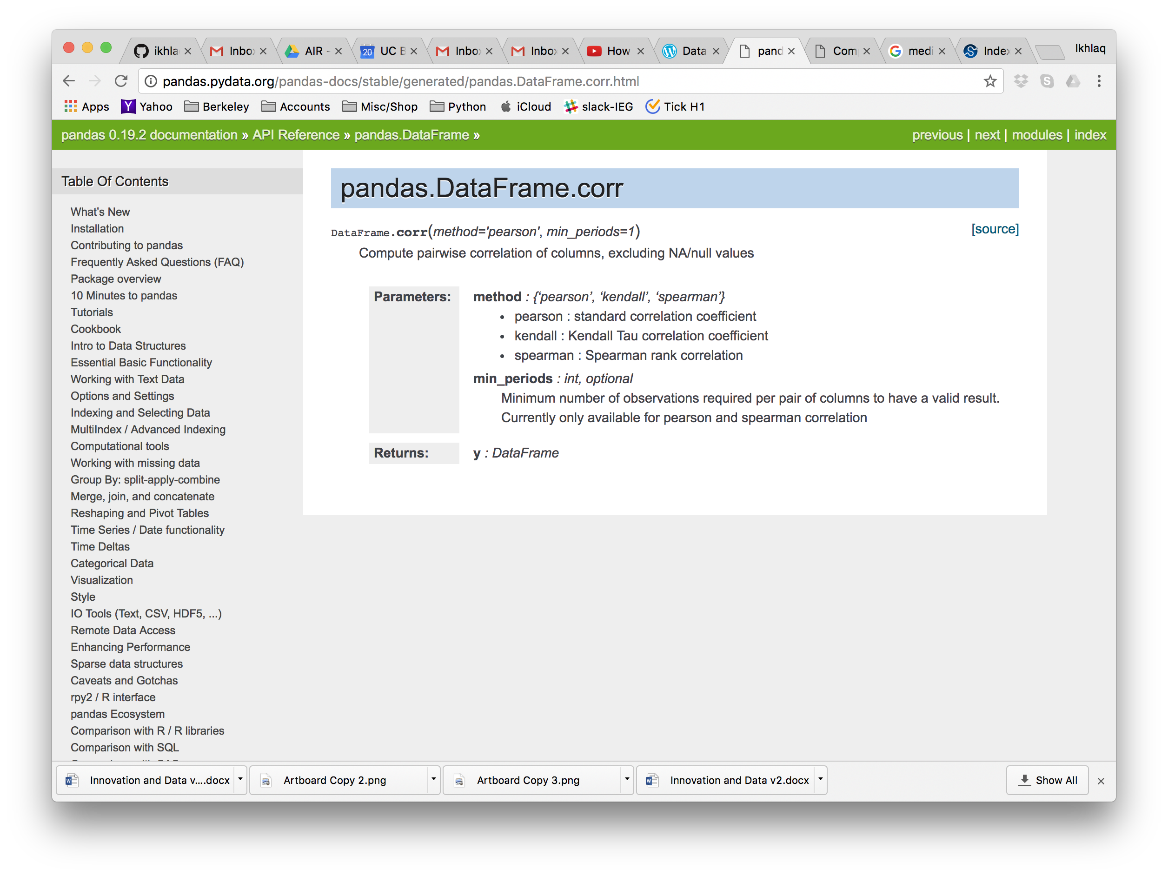
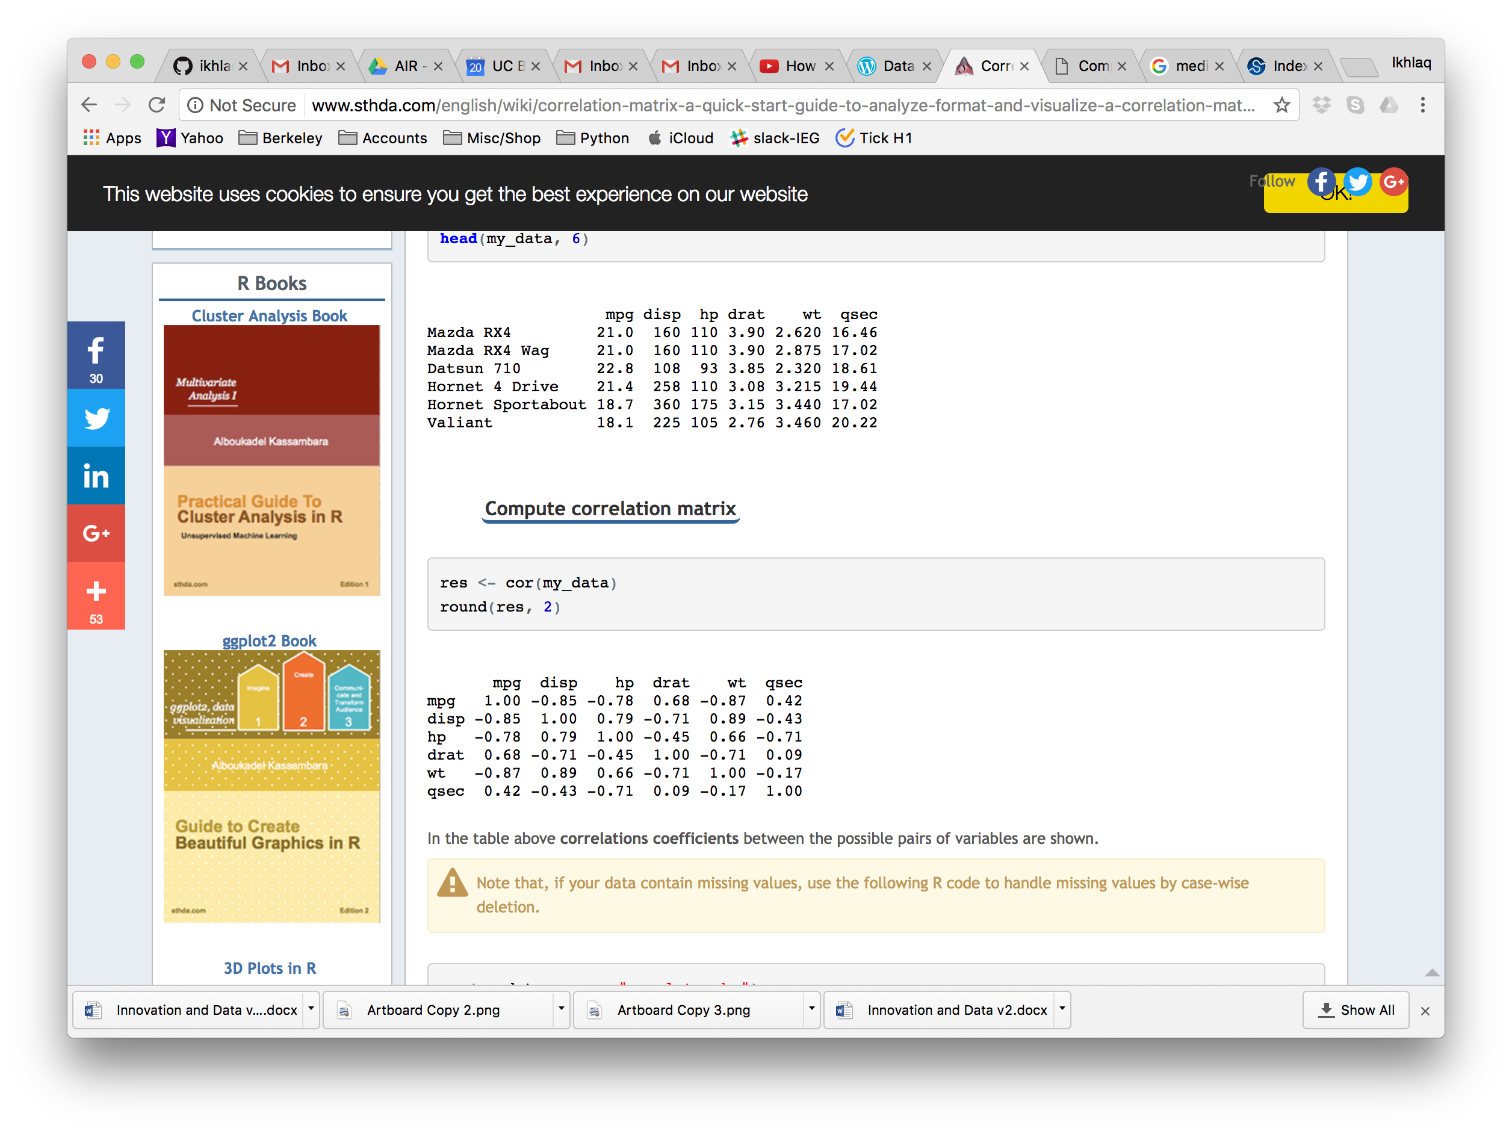
Correlation of Features from Different Sources
Pandas Table
Use corr()
Ie dataframe.corr()

Slide 21
Pandas will create a correlation matrix with “columns”

Slide 22
Correlation Matrix with multiple sources and time segments
x1 x1 x1 x2 A B C D
Window W
A B C D
Sources
Samples
1
2
3
.
W
A
B
C
D
A
B
C
D
Corr
Matrix
x1
C
B
A
x2
D
Time 1 2 3 4 5 6 … t
Implement with a slice
Why would you want a correlation matrix like this?

Slide 23
Correlation Matrix with multiple sources and time segments
1
Suppose this is x1
as an array of numbers 0 0 1 1..1 0 0 0
0
1
Suppose this is x2
100
What is np.corr(x1,x2[n:n+w])?
Notes:
Function of n, max at n = 100

Slide 24
Data Sequence in Tables Example
Preprocess:
Filter/
Convolution
Correlation
Mean, Var, stats
Freq. /Spectral
Windows of time
Apple
.
.
Google
Correlation
Matrix
data
features
Discrete data for
each source
A, B, C..
x_{n} = x1, x2, x3, …
Data Input and
Temp Storage
Preprocess
(and lose
some information)
Descriptive Statistics

Slide 25
Covariance: Alternative Format

Slide 26
Properties of Correlation

Slide 27
Properties of Correlation

Slide 28
Properties of Correlation

Slide 29
More Conversions from Real Time Data
Single Signals (an array)
Fourier Tansform: DTFT and FFT -> features that have spectral information
Pattern Matching -> feature = does the pattern exist, or how strongly
More types of scoring: mapping a vector to a single number
Multiple Inputs (multiple arrays or a matrix)
Cross correlation matrix
Jacobian Matrix – What is causing the most change?

Slide 31
End of Section

